Slide 1
What makes for a successful merger?
Peter Scott
Peter Scott consulting
www.peterscottconsult.co.uk

Slide 2
Putting mergers into context
PETER SCOTT CONSULTING
The economy
Legal Services Act implications
Client needs are changing
Greater regulation and compliance
PI insurers’ attitudes
Technology
Globalisation
A need to become more competitive
A greater need for resource

Slide 3
The essentials to success
PETER SCOTT CONSULTING
Planning and negotiating mergers
Dealing with potential deal breakers
Financial considerations
Management and implementation issues

Slide 4
Why merge?
Planning and negotiating mergers
PETER SCOTT CONSULTING

Slide 5
Merge for the right reasons
consolidation is not a strategy – it is a means to an end – to gain competitive advantage
consolidation can help build RESOURCE – to enable a firm to provide its clients with what they want
Firms need to ask themselves:
“Will we be able to achieve our objectives on our
own”
If not, then consolidation may need to be considered

Slide 6
A Vision
To build a law firm which can begin to
compete with larger, more developed
firms for better quality, higher value
work leading to greater
competitiveness and profitability

Slide 7
The scale of a new firm may help to enable…
the new firm to be developed at an
acceptable economic cost to each
constituent firm
- which the individual firms could not on their own provide

Slide 8
Resource to enable the new firm to…
Attract and retain the best
talent

Slide 9
Resource to enable the new firm to…
Provide clients with the depth
and breadth of expertise they
now require, where and when
they need it

Slide 10
Resource to enable the new firm to…
Build the quality management
which will be required to
successfully compete in the
future

Slide 11
Resource to enable the new firm to…
Provide the necessary
infrastructure to underpin the
effective provision of high
quality professional services
demanded by clients

Slide 12
Developing the vision
PETER SCOTT CONSULTING
Before you approach your target
Look beyond what each firm now represents and consider what the two firms together could build
To excite and enthuse both sets of partners
The leaders of both firms need to be ‘ad idem’ on the vision

Slide 13
Ensure CULTURES are compatible
PETER SCOTT CONSULTING
Compatible – not necessarily the same – the laws of magnetism!
Are we like them?
Do we have the same work ethos?
Can we see ourselves working well together?
Do we like them?
If not – walk away

Slide 14
Develop a strong business case
PETER SCOTT CONSULTING
Merger is not a strategy – it is a means to an end
Develop a tested business case
- will it be good for clients?
- will it have the ‘wow’ factor?
Will merger help you win more and better quality work from existing clients and new work from potential clients, that neither legacy firm could hope to win individually?

Slide 15
Develop a strong financial case
PETER SCOTT CONSULTING
A merger
- with a strong business case
- if well implemented
- should achieve greater profitability
But – inevitable disruption of merger will mean even greater financial management is required
Carry out a financial evaluation covering first [2] years based on realistic and prudent assumptions
NB – do not believe your own hype!

Slide 16
Dealing with potential ‘deal breakers’
PETER SCOTT CONSULTING

Slide 17
Potential ‘deal breakers’
PETER SCOTT CONSULTING
Partners
Name
Goodwill
Financial performance
Profit sharing
Management positions
Successor practice rules
Others?

Slide 18
Partners
PETER SCOTT CONSULTING
How many of your equity partners are
you going to bring into the merged firm?

Slide 19
Partners
PETER SCOTT CONSULTING
Managing the
- insecurities
- ambitions
of partners

Slide 20
Name
PETER SCOTT CONSULTING
The goodwill of your firm is likely to
reside in the abilities and reputation of
your partners as a group, rather than in
your firm’s name.

Slide 21
Goodwill
PETER SCOTT CONSULTING
Someone will most likely have to bear the
pain of writing off goodwill as the price of
achieving the merger

Slide 22
Profit sharing
PETER SCOTT CONSULTING
An opportunity to make a new start
Can reflect different ‘cultures’
May need a transition to a different system

Slide 23
Management positions
PETER SCOTT CONSULTING
Managing the ambitions of partners
The leaders of each need to be ‘ad idem’

Slide 24
Do your due diligence!

Slide 25
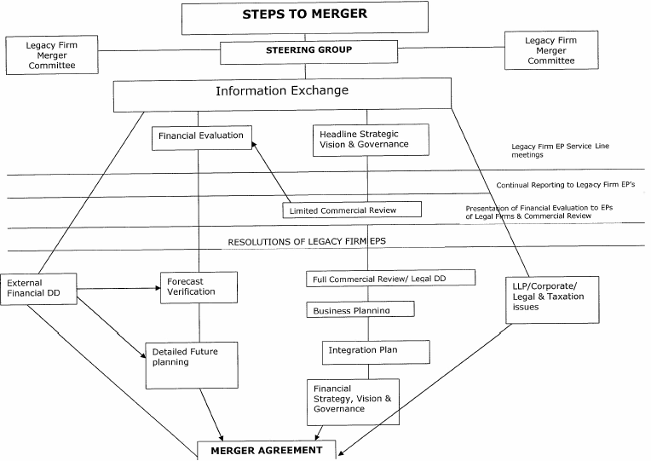
A merger flowchart
PETER SCOTT CONSULTING

Slide 26
The merger process does not end on signing the agreement
PETER SCOTT CONSULTING

Slide 27
Management and implementation
PETER SCOTT CONSULTING
The hard work begins once the merger agreement is signed!
Management and implementation are key to success

Slide 28
Management and implementation
PETER SCOTT CONSULTING
Do we have a MANAGEMENT TEAM
capable of successfully taking forward our
new firm to achieve our vision?
Do we have the required skills?
Do we have the leadership required?

Slide 29
Management and implementation
PETER SCOTT CONSULTING
Assemble the best possible TEAMS to manage integration
of the two firms and longer term management:
- to manage groups / offices / projects
- to manage
- finance
- risk and compliance
- HR
- marketing
- IT
- facilities
- other functions

Slide 30
Management and implementation
PETER SCOTT CONSULTING
Learning from each other
How can we incorporate the best of our respective firms into the new firm?
How are we going to manage performance in the new firm?
How are we going to change things?

Slide 31
The merger process needs to be managed

Slide 32
Communicate, communicate, communicate
PETER SCOTT CONSULTING
Internally
- What will it mean for me?
Externally
- Will the market place give our merger the thumbs up?
Ideally, use external professional advice

Slide 33
Mergers can deliver their promises – if those involved never lose sight of the real objective – to build a more competitive and profitable firm

Slide 34
PETER SCOTT CONSULTING
Any questions?
Notes:
34

